Slide 1
Task:5
Mega research/analysis

Slide 2
Task 1: Genre and Language
Film | MES | Sound | Editing | Camera Angles
Friends with Benefits | This film is set in beautiful New York City so there are a lot of scenes outside on the streets, in the office and in the apartment. Due to the genre of this film, it is mostly filmed in well-lit areas so there is high-key lighting, to highlight the characters’ expressions. The main characters are usually dressed in business wear as they work for GQ, however other than this they are usually wearing casual clothing. | As this film is a romantic comedy, the film soundtrack consists of light-hearted/love songs such as ‘Closing Time – Semisonic’, ‘Runaway Baby – Bruno Mars’ and ‘Girls Fall Like Dominoes – Nicki Minaj’; all the songs in the film are well known songs as they are performed by successful artists which therefore appeals to a wider demographic. | Editing in this film is quite quick and snappy in some parts, to show the main characters’ body language and facial expressions whenever they are having conversations. However, usually when the characters are having a serious conversation, the shots are longer as the editors want the audience to capture the full moment. | In this film, the majority of camera angles are over the shoulder shots as most scenes include the conversation between the two. There is also a combination of close up and mid close up shots so that the audience can focus on the character’s emotions.
Film | MES | Sound | Editing | Camera Angles
Maze Runner | As this is an action film, it has a combination of both low and high-key lighting; high-key lighting is used to establish the magnificent views of where certain scenes are set, whereas low-key lighting is used during scenes where the characters are in danger for example shooting/fighting scenes. The characters’ outfits consist of casual protective clothing such as jackets, combat trousers, jumpers and simple t-shirts as they are not worried about getting them dirty or ruined during their fighting scenes. | Due to the many fight/shooting scenes, there are a range of sound effects such as explosions and objects being destroyed. Alongside this, there is also face paced music to intensify the climatic build-up of certain scenes, such as their fight for survival when searching for the cure. | Camera shots in this film are mostly quick, short and snappy to create a face paced atmosphere during the main action scenes. This is something the majority of action films do to intensify the tension between characters. | Camera angles in this film include wide establishing shots to show the audience where the scenes are taking place and also to portray the potential risks and dangers the characters might have to go through.

Slide 3
Task 2: Techniques
Get Out ‘The Sunken Place’ scene: https://youtu.be/kBwVWrBk_uo
The Devil Wears Prada ‘Andy Gets a Makeover’ scene: https://youtu.be/HSPYgwP9R84
The Maze Runner (2014): https://youtu.be/_lwE2IdDeWE
Similarities | Differences
In the scenes from Get Out and The Devil Wears Prada, both films use the over the shoulder camera angles when two characters are having a conversation, usually in mid shots to focus on the characters’ facial expressions while also still being able to see the other character. All these films follow the codes and conventions of their genre, for instance through their use of lighting; The Devil Wears Prada uses mostly high-key lighting to show that it is a jokey light, hearted genre whereas Get Out and The Maze Runner use low-key lighting to portray the darkness and mystery of the film, with a lot of dark tones and shadows to create dramatic scenes. | I noticed that in The Maze Runner, wide angle and establishing shots are used quite often to show the audience the setting rather than close up or mid shots, unless characters are having a deep conversation. There are also differences in editing techniques where the non-diegetic background music, for example in The Maze Runner, will match up with the cutting of scenes to intensify the fast paced actions within the scenes whereas other films of different genres such as ‘Get Out’ which is a horror/thriller, will use the non-diegetic sound to slowly create a build up of tension.

Slide 4
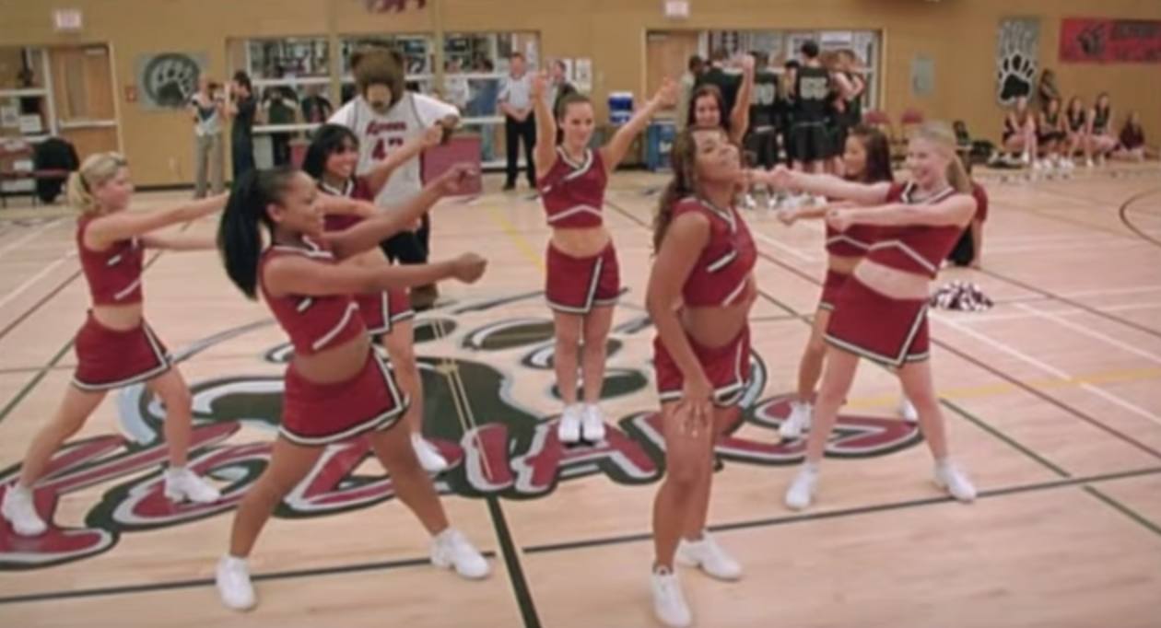
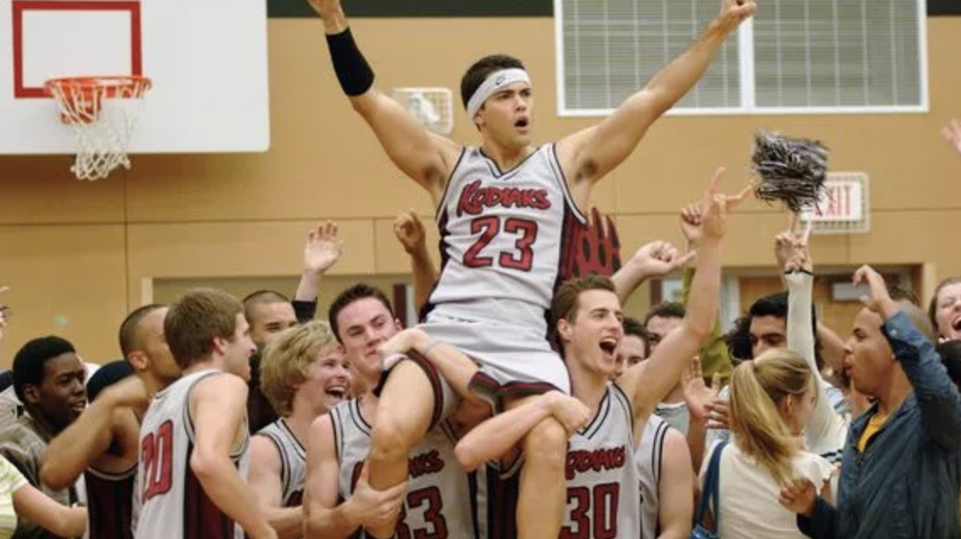
Task 3: Representation
In romantic comedies or American teen movies, the genders are usually represented through the stereotypical high school groups of girls being the ‘cheerleaders’ and the boys being the ‘jocks’. This highlights codes and conventions for this genre, portraying that these types of groups in high schools were always the popular crowd and everyone else were known as ‘geeks’ or ‘nerds’.

Slide 5
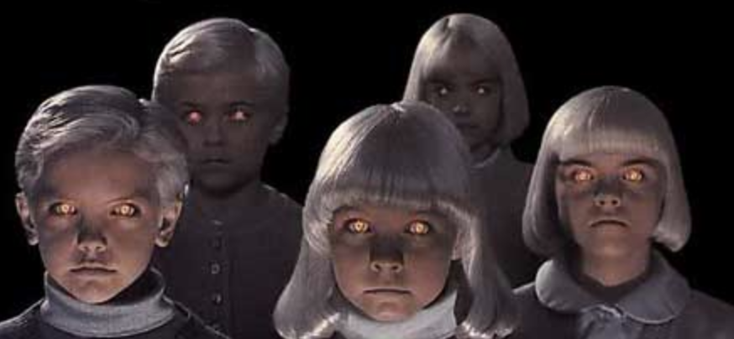
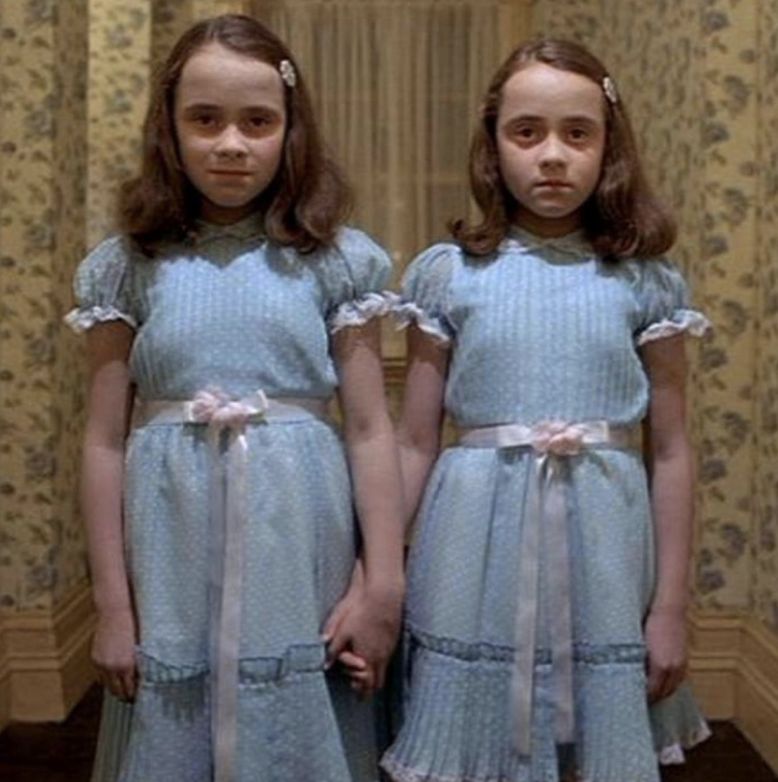
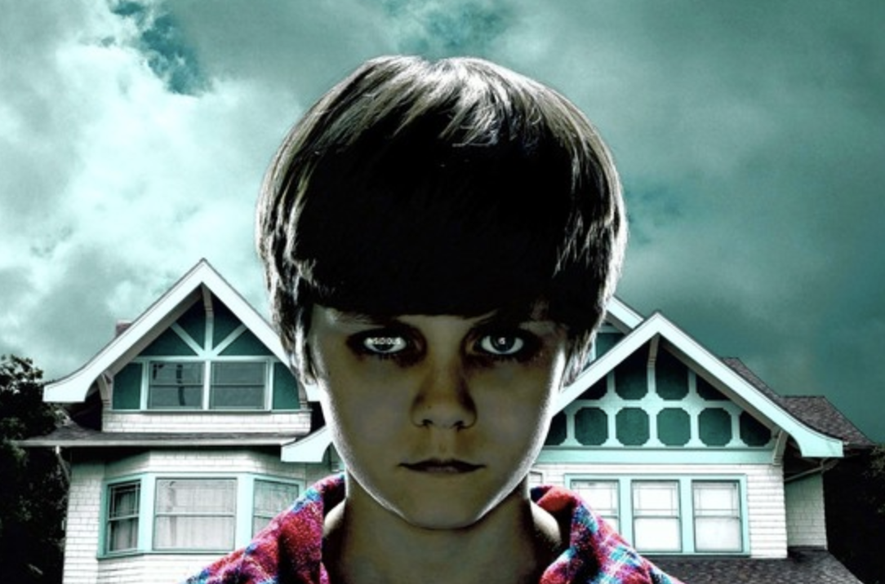
Representation
In many horror films, children are represented as the evil characters, usually due to possession of demons or spirits. This is quite common in this genre as it breaks the stereotypical representation of children being sweet and innocent, and instead are used to symbolise evil. This is a popular concept as it can be seen as unusual and disturbing to audiences, however the theme still appeals to them as it is something different.

Slide 6
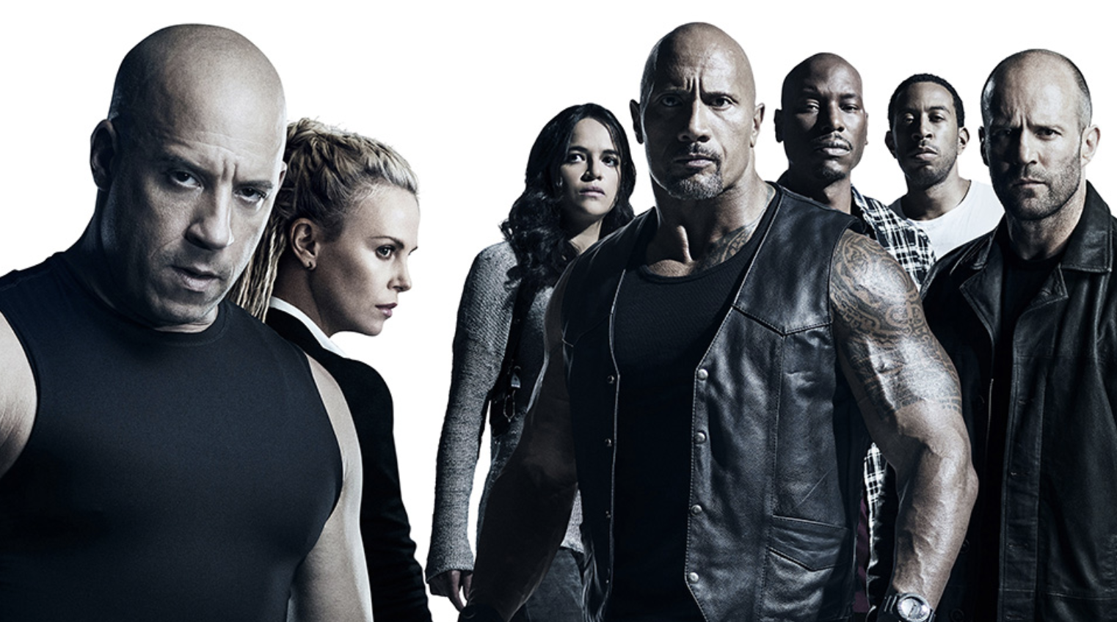
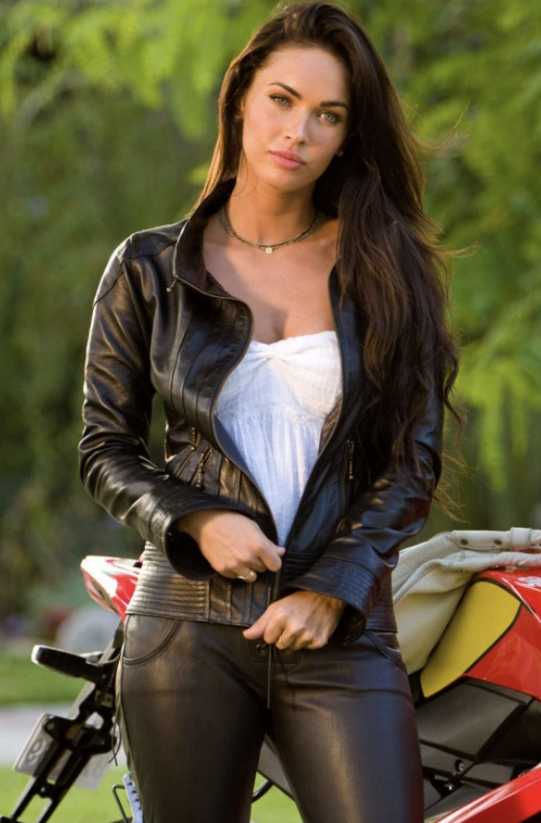
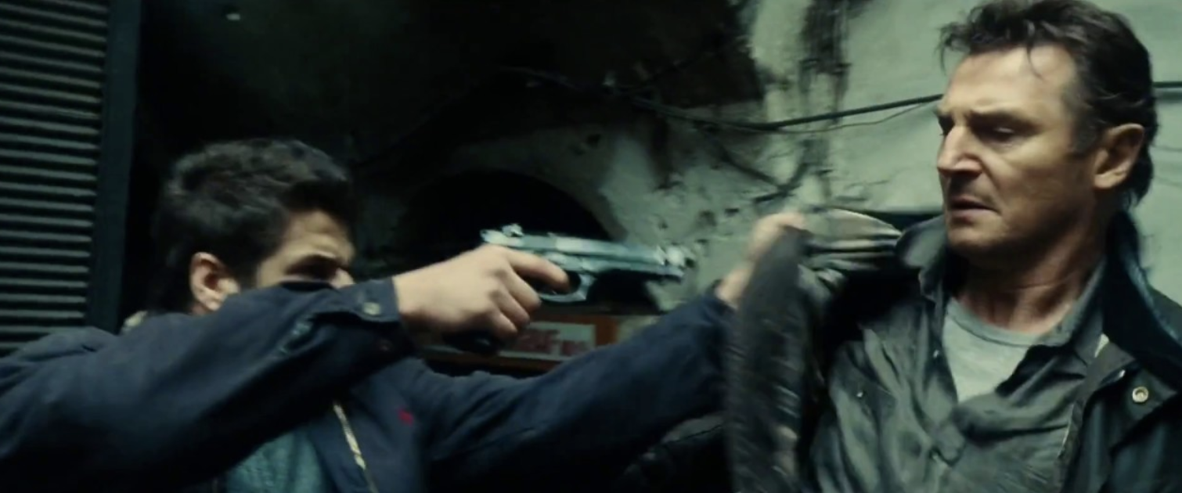
representation
In most action films, characters are usually represented through their clothing, for instance the male characters wear dark clothing with a leather jacket to portray a ‘bad boy’ image while the female characters also dress in this type of style to convey the ‘sexy bad girl’ image, complimenting the men’s style. This is done to symbolise the fact that both genders are strong and can work together to fight.

Slide 7
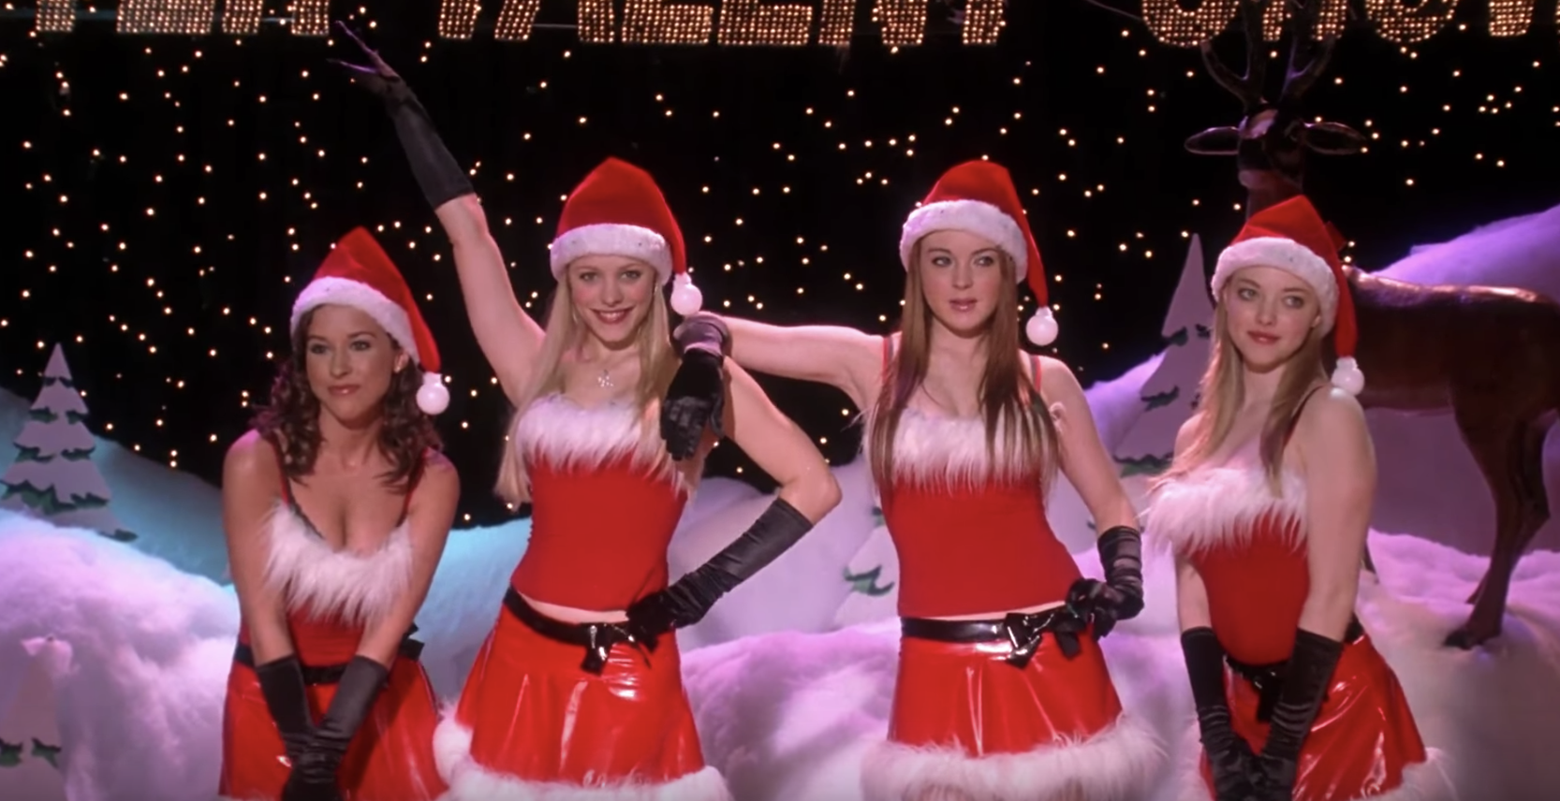
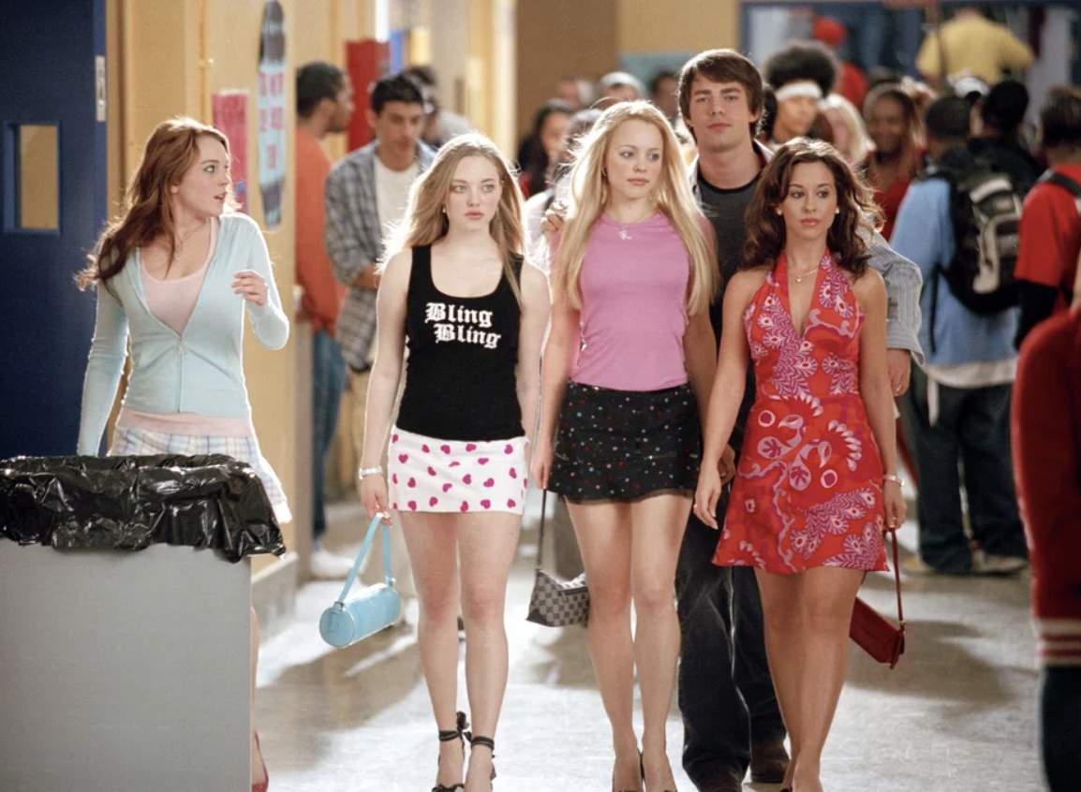
Task 4: Theory - Mean girls movie
In this film, Laura Mulvey’s Male Gaze theory can be applied; this is the ideology that visual media is essentially created from the perspective of a heterosexual male. For example in Mean Girls, these specific scenes show the girls wearing fairly provocative clothing and showing plenty of skin which leaves the impression, especially on females, that they should look a certain way in order to gain attention from men. As you can see in the second image a group of boys are crowded behind while the girls are positioned in the centre of the frame to show that all eyes are on them and are the centre of attention. This therefore conveys the idea to the audience that it is okay for women to be objectified.
During the ‘Jingle Bell Rock’ scene (first image), the camera mainly focuses on the way the girls move their bodies and the way they look which highlights the ideology that girls have to be ‘sexy’ with the way they move in order to please and gain male attention. This can create negative ideologies towards audiences, especially younger teens as this can result to insecurity of the way they look, therefore affecting their self-esteem.

